Slide 1
ECE554 SMS System I/O
Tsung-Hao Chen
Tsung-Chi Lin

Slide 2
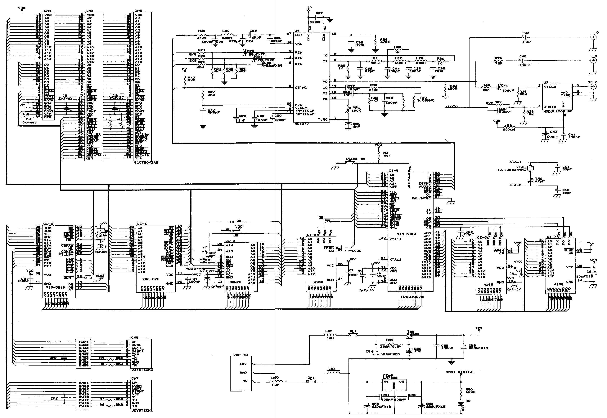
SMS Schematics

Slide 3
I/O and Memory Access
All devices and memory share the same address bus and data bus.
For input/output type of instructions, Z80 sets IORQ. The lower 8-bit address is the port number, and data goes through the data bus.
For load type of instructions, Z80 sets MREQ. The 16-bit address is the virtual address and the data goes through the data bus.
Virtual address from Z80 is mapped to physical address by the memory paging chip.

Slide 4
Memory Mapping
Reason for Memory Paging
  Only 16-bit Address supported by Z80
  Need to handle up to 512 KB ROM + 16 KB RAM ( need more than 19 bits )
Memory Map summary
  On-board User RAM ( 8KB X 2 )
  ROM Frame 0, 1, 2 ( each 16KB of size )
  Frame Control Registers
Frame Control Registers (FCR’s)
  $FFFC : RAM select register
  $FFFD : Frame 0 ROM bank
  $FFFE : Frame 1 ROM bank
  $FFFF : Frame 2 ROM bank

Slide 5
Memory Paging Scheme
How does it map the address ?
  Maps 16 KB Pages into 16 KB frames in Main Memory
  Only 3 frames ( Total 48 KB ) can be simultaneously mapped to ROM
  Swap pages in and out of the frames through 3 FCR’s (Frame Control Registers)
  Remaining 16KB ( 64-48 ) maps to the user RAM except FCR’s

Slide 6
Starting Address (hexadecimal)
Description
0x0000
First 1 kilobyte of ROM page 0
0x0400
Frame 0, (Last 15 kilobytes, first kilobyte is always from page 0)
0x4000
Frame 1
0x8000
Frame 2
0xC000
Program RAM
0xE000
Mirror of Program RAM (minus last four bytes)
0xFFFC
Control byte for Frame 2 (described below)
0xFFFD
Page to go into Frame 0. (Only last 15 kilobytes of selected page. The first kilobyte is always from ROM page 0.)
0xFFFE
Page to go into Frame 1
0xFFFF
Page to go into Frame 2
Sega Master System Main Memory Map

Slide 7
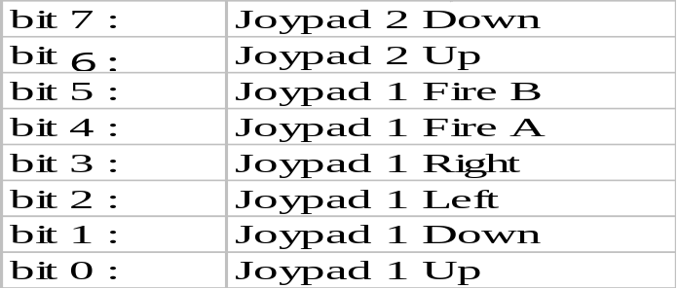
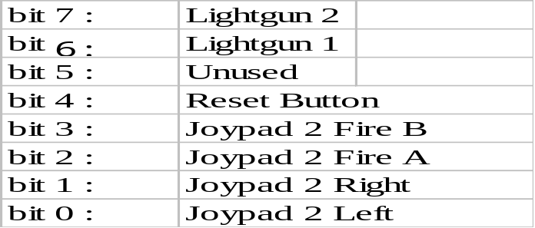
Joypads
PORT $DC ($C0) – Joypad port 1 (read only)
  Each bit corresponds to a button
  0 for pressed, 1 for released
  Bits meaning :
PORT $DD ($C1) – Joypad port 2 (read only)
  Bits meaning :
Any kinds of joypads are okay (serial or parallel)

Slide 8
Sound Chip
Use port 0x7E and 0x7F
YAMAHA YM2413 Chip
  FM Sound Generator for real sound creation.
  2 selectable modes
    9 simultaneous sounds
    6 melody sounds plus 5 rhythm sounds
  Built-in Instruments data (15 melody tones, 5 rhythm tones) .
  Built-in DAC

Slide 9
Interrupt
IRQ (Maskable Interrupt)
  SMS is always used in interrupt mode 1. It causes a jump to location $0x0038 when an interrupt is generated
  Generated by the VDP chip on each vertical blanking impulse (VBlank)
  An interrupt occurs every 1/60 second (not sure)
NMI (Non Maskable Interrupt)
  Generated when the Pause button is pressed
  Causes an unconditional processor jump to address $0x0038

Slide 10
Our FPGA Implementation
FPGA
Z80
16 addr
Graphic
VGA RAMDAC
8 data
Joypad Controller
Left Bank RAM
Some Pins
Memory Paging Chip
19 addr
YM2413
(If possible)
Audio CODAC

